Slide 1



Home Loan Prediction
CP-III PROJECT
CREATED BY :
YASH MODI (21012532001)
VAMSI Mekala (20012531039)

Slide 2
VISION AND MISSION OF
VISION
IT SHALL BE THE CONSTANT ENDEAVOUR OF GANPAT UNIVERSITY TO MEET THE EDUCATIONAL NEEDS OF THE YOUTH IN THE AREAS OF PROFESSIONAL STUDIES AND PROVIDE STATE-OF THE ART LEARNING OPPORTUNITIES ALONG WITH INCULCATION OF VALUES OF COMMITMENT AND UPRIGHTNESS.
MISSION
SEEK, SEARCH AND OFFER PROGRAMS THAT LEAD TO SYMBIOTIC EMERGENCE OF 'ACADEMIC EXCELLENCE' AND 'INDUSTRIAL RELEVANCE' IN EDUCATION AND RESEARCH.

Slide 3
VISION AND MISSION OF COMPUTER ENGINEERING / INFORMATION TECHNOLOGY DEPARTMENT
VISION
DEPARTMENT AIMS TO ACHIEVE ITS RECOGNITION AS A LEADING CONTRIBUTOR IN THE AREA OF TECHNICAL EDUCATION OF COMPUTER ENGINEERING BY PRACTICING LATEST PRINCIPLES, TOOLS AND TECHNOLOGIES TO COPE WITH CURRENT AND FUTURE CHALLENGES AND HENCE CONTRIBUTING TO GLOBAL WELFARE.
MISSION
TO EDUCATE AND INCULCATE STRONG FUNDAMENTALS OF SCIENCE AND COMPUTER ENGINEERING THROUGH BEST TEACHING LEARNING PRACTICES.
TO IMPART HIGH QUALITY EDUCATION TO ACQUIRE SKILLS TO CONDUCT RESEARCH AND SOLVE COMPLEX PROBLEMS THROUGH MODERN TOOLS, TECHNOLOGIES AND INNOVATIVE PRACTICES.
ENABLING YOUTH FOR EMPLOYABILITY, SOCIAL UPLIFTMENT, FOLLOWING GOOD MORAL PRACTICES AND PROFESSIONAL ETHICS.
PREPARING YOUTH FOR CONTRIBUTING IN ADVANCEMENTS OF TECHNOLOGY AND SOCIETY.
ENCOURAGING STUDENTS TO BE ADAPTIVE, COURAGEOUS AND LIFE-LONG LEARNERS.

Slide 4
CAPSTONE PROJECT - III Course Outcomes
AFTER SUCCESSFUL COMPLETION OF THIS COURSE, STUDENT WILL BE ABLE TO:
CO1 Identify the problem by applying acquired knowledge
CO2 Analyze and categorize executable project modules after considering risks
CO3 Choose efficient tools for designing project modules
CO4 Combine all the modules through effective team work after efficient testing
CO5 Develop professional etiquette to work in a diverse team.
CO6 Integration and application of knowledge and skills acquired
CO7 Bring novel ideas into innovation
CO8 Technical report writing. Elaborate the completed task and compile the project report

Slide 5

TABLE OF CONTENT
INTRODUCTION
Problem Statement
Importance of Home Loan Prediction
Key Factor in Home Loan Prediction
How You Can Predict Loan Approval
Algorithm We Used
Advantages
Functionalites
Conclusion

Slide 6

INTRODUCTION
A Finance company deals with home loans and has its reach spread across all urban,semi-urban and rural areas.
Eligibility for the home loan is based on customer details provided while filling an application form. This process is necessary to avoid frauds and reduce company losses.
The company wants to process the loan eligibility checking to get automated These details like Gender, Marital Status, Education, Number of Dependents, Income, Loan Amount, Credit History and others.

Slide 7
Problem Statement
In the context of housing finance the problem is to develop a predictive model that can accurately forecast the likelihood of home loan approval/ rejection for the respective borrowers.
The goal is to leverage historical loan application data along with relevant borrower information and credit metrics, to build a robust M.L model that leads to lending institutions in making informed decisions.

Slide 8
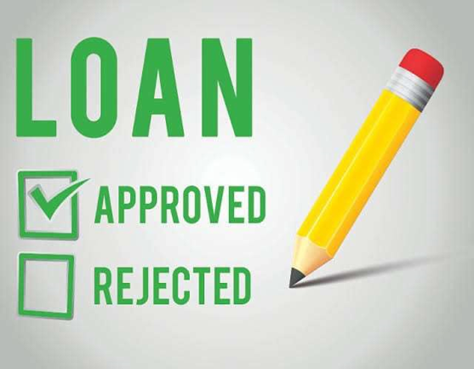
Importance of Home Loan Predictions
Home loan prediction helps lenders assess the creditworthiness of borrowers, ensuring they can repay the loan amount.
It reduces the risk of default, allowing lenders to make informed decisions and minimize financial losses.
Accurate home loan prediction promotes responsible lending practices, benefiting both lenders and borrowers.

Slide 9
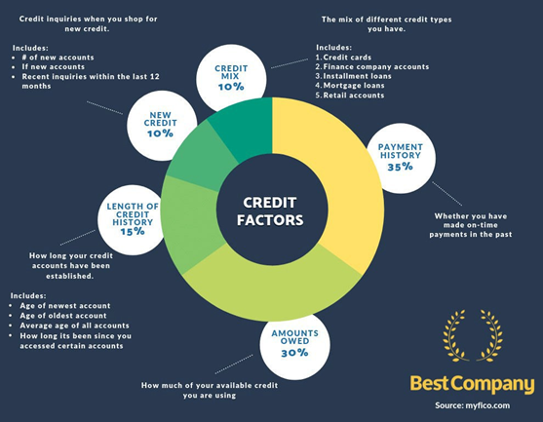
Key Factor Of home loan prediction
Credit Score: A borrower's credit score is a crucial factor that indicates their creditworthiness and ability to repay the loan.
Income and Employment Stability: Lenders evaluate a borrower's income level and employment history to assess their ability to meet mortgage payments.
Debt- to- Income Ratio: This ratio helps determine if a borrower has excessive debt compared to their income, impacting their ability to repay the loan.

Slide 10
how you can predict loan approval
Predicting loan approval involves using a model to assess the likelihood of a loan application being approved based on various financial and personal factors. Here's how you can predict loan approval
1. Data Collection and Input
Gather relevant information from the loan applicant, such as income, credit score, employment status, loan amount, loan term, and other necessary financial details.
2. Data Preprocessing
Clean and preprocess the collected data, addressing missing values, outliers, and inconsistencies.
3. Feature Engineering
Create additional features that might provide valuable insights, such as debt-to-income ratio or loan-to-income ratio.

Slide 11
how you can predict loan approval
4. Model Selection and Training
Choose a suitable machine learning algorithm for loan prediction, such as logistic regression, decision trees, or random forests.
5. Input Transformation
Prepare the loan applicant's data in the same format as used during model training.
6. Prediction
Feed the applicant's data into the trained model to obtain a prediction of loan approval or rejection.
7. Display Result
Present the prediction outcome to the loan applicant, indicating whether their loan application is likely to be approved or not.

Slide 12
Algorithm we used
Logistic Regression
Logistic Regression is a statistical method for binary classification that models the relationship between input features and the probability of an event using a logistic function.

Slide 13
Algorithm we used
Rendomforest classifier
a RendomForest Classifier is like a team of decision-making experts who come together to make a group decision. Imagine you have a big decision to make, and instead of relying on just one person, you consult multiple individuals with different perspectives.

Slide 14
Algorithm we used
Rendomforest classifier
think of a Decision Tree as a flowchart for making decisions. Imagine you want to play a game, and you have a friend who's really good at suggesting the next move. Your friend asks you a series of yes-or-no questions based on the situation, leading you to the best choice.

Slide 15
Advantages
Efficiency : Home Loan Prediction automates the loan approval process, reducing manual effort and streamlining the workflow for financial institutions
Accuracy: Predictive models analyze historical loan data and applicant information to make accurate loan approval predictions, minimizing errors and improving decision-making.
Long-Term Planning : Historical loan data and predictive models allow lenders to plan for future loan demand, optimize marketing efforts, and anticipate market trends.
Risk Management : Home Loan Prediction helps lenders assess the risk associated with loan applicants more accurately, leading to better risk management and reduced loan defaults

Slide 16
Functionalites
Data Collection and Preprocessing: Collect relevant information from the customer, such as their income, credit score, employment status, loan amount, loan term, existing debts, and any other necessary financial details.
Machine Learning Models: Utilize various machine learning algorithms to build the loan prediction model, such as logistic regression, decision trees, random forests, gradient boosting, or neural networks.
Real-time Prediction: Enable the system to make loan approval predictions in real-time based on new applicant data, ensuring quick responses to loan applicants.
Performance Monitoring and Feedback: Continuously monitor the model's performance and allow users to provide feedback to improve its accuracy and effectiveness over time.

Slide 17
Conclusion
In conclusion, the Home Loan Prediction project has been a significant endeavor in harnessing the power of data-driven insights to improve the home loan approval process. Throughout this project, we have successfully developed and evaluated a predictive model that can accurately forecast the likelihood of loan approvals or denials for prospective borrowers.

Slide 18
Thank you

